Slide 1
Rock, Paper, Scissor Game
Presentation by Pach Bálint

Slide 2
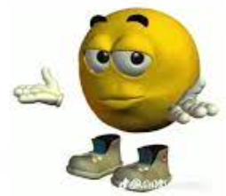
First Thoughts.
First of all, when we got the project from our teacher, we were thinking about something simple, something not too hard.
So we did Rock, Paper, Scissor. Simple as that.
We tried a lot of different code’s from internet, to work with, and we finally found everything, that we needed for this game.
We did the game in Visual Studio Code.

Slide 3
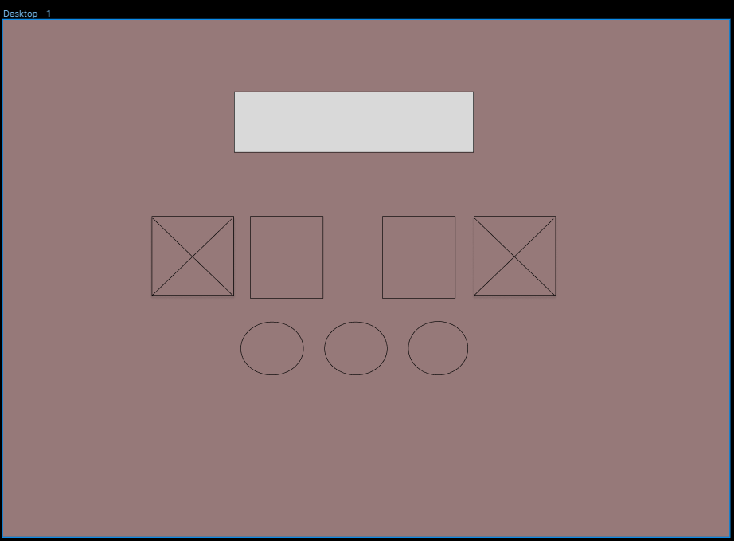
Figma.
This is the „Prototype”
That, I did on Figma.
I needed to do that „body”
to know, how it would look when we going to start the whole project.
I mean for the result, it was better that I thought.

Slide 4




So, how is our game working?
It’s really simple.
Here are the buttons ⬇️
With this, you show Rock
With this, you show Paper
With this, you show Scissorrs
Simple, right?

Slide 5
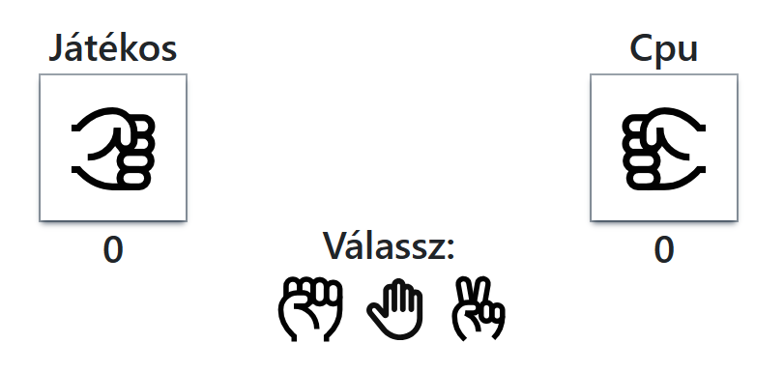
This is how, our game look’s like:
So, you need to click on one of the icons, that I showed you, in the earlier dia, and the CPU or AI (you name it) going to click on one of them randomly.

Slide 6
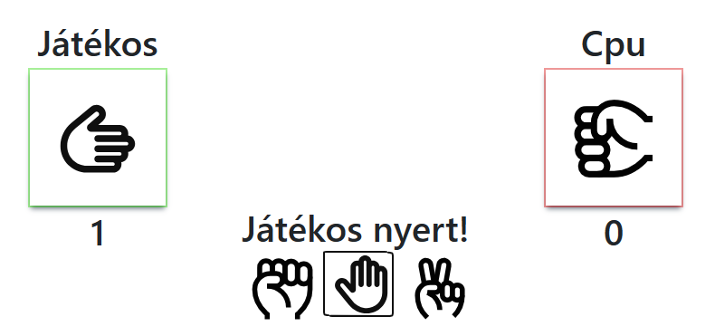
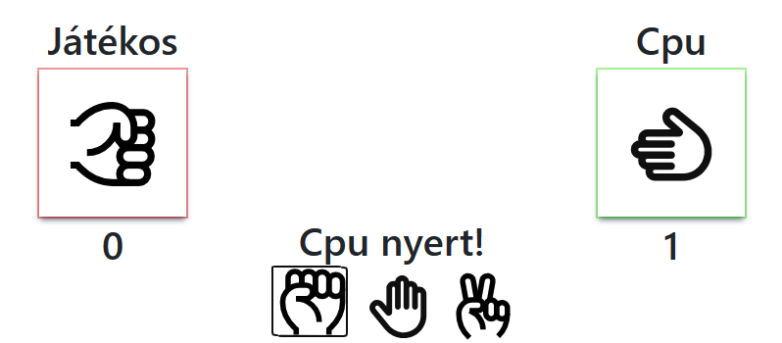
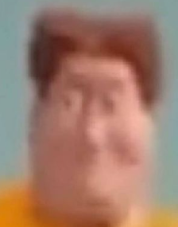
This is how it looks when you WIN/LOSE
If you win, there is going to be a green box around your chosen icon.
If you lose, there is going to be a red box around you, so it’s basically switching.

Slide 7
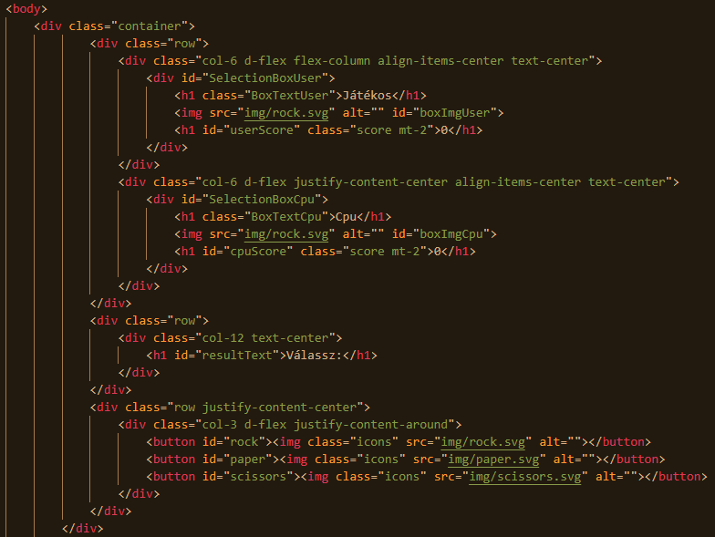
We going to talk a bit about the code now. HTML
We used HTML to create the Body, and the Layer for the webpage.
This is the page where you can find the buttons, and everything about them.

Slide 8
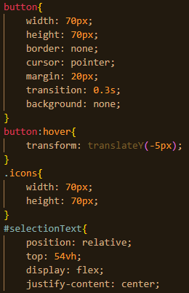
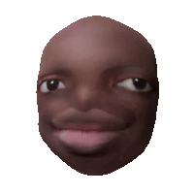
CSS and everything about it.
We used CSS for the background and the buttons.
We can manage the colour, style, size and even their places on the webpage.
You can adjust literally everything in CSS.

Slide 9
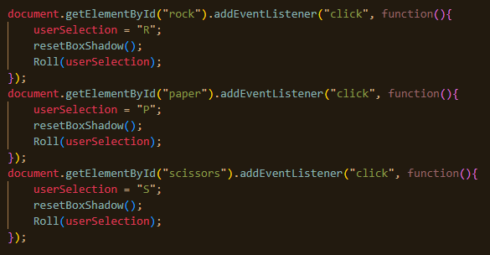
JavaScript
We needed JavaScript for the animations for the website.
All the motions, and functions is powered by the JavaScript code:
This code is the most important thing in JavaScript

Slide 10
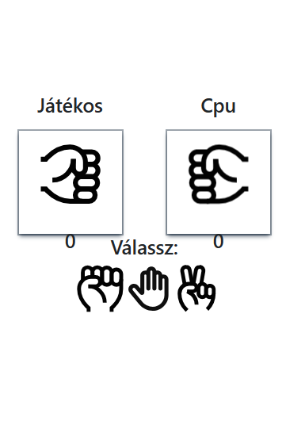
For closing:
Our website is responsive, I showed the PC view already, but there is the mobile view:
Thank you all, for watching! ❤️

